Slide 1
DESSERT
Dr Nair Anishkumar

Slide 2
Hemodynamic classification of VSD
Restrictive-
LVSP > RVSP
pulm /aortic systolic pressure ratio < 0.3
Qp / Qs<1.4/1
Moderately restrictive –
RVSP high, but less than LVSP
- Qp/Qs 1.4/2.2
Non restrictive -
RVSP , LVSP, PA , Aortic systolic pressures equal
Qp/Qs >2.2
Flow determined by PVR

Slide 3
PDA classification
Large PDA - ≥ diameter than 1 of the proximal branch pulmonary arteries.
Moderate PDA < diameter than 1 of the proximal branch pulmonary arteries with some degree of LA/LV dilation.
Small PDA - no dilation of the left atrium or left ventricle.

Slide 4
PULMONARY HYPERTENSION HISTOLOGIC CLASSIFICATION

Slide 7
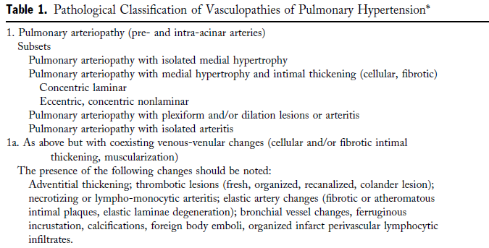

Slide 8
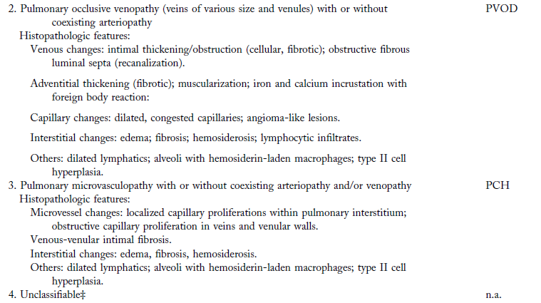

Slide 9
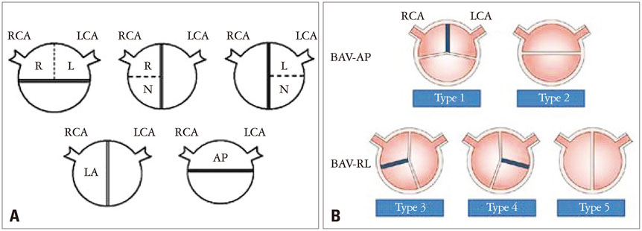
TYPES OF BICUSPID AORTIC VALVE
Notes:
Diagrams showing the classic (A) and new (B) classification of bicuspid aortic valve phenotypes. The classic classification is basically based on demonstration of two fused aortic cusps, whereas new classification on the orientation of the fused bicuspid aortic valve
AP: anterior-posterior, BAV-AP: bicuspid aortic valve with fusion of the right and left coronary cusps, BAV-RL: bicuspid aortic valve with fusion of the right or left coronary cusp and noncoronary cusp,

Slide 10
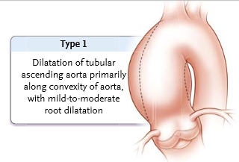
BAV Aortopathy
The most common type,
Associated with an older age at diagnosis (>50 years), valvular stenosis and the RL fusion pattern

Slide 11
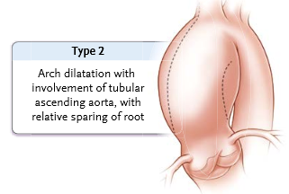
BAV Aortopathy
Frequently extending into the transverse aortic arch and RN fusion pattern

Slide 12
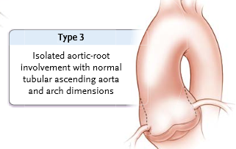
BAV Aortopathy
Type 3 also called the root phenotype
Associated with a younger age at diagnosis (<40 years), male sex, and aortic regurgitation
This type ofbicuspid aortopathy is most likely to be associated with a genetic cause

Slide 13
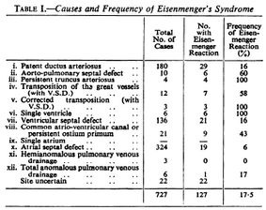
Frequency of Eisenmenger- Paul wood series

